Slide 1
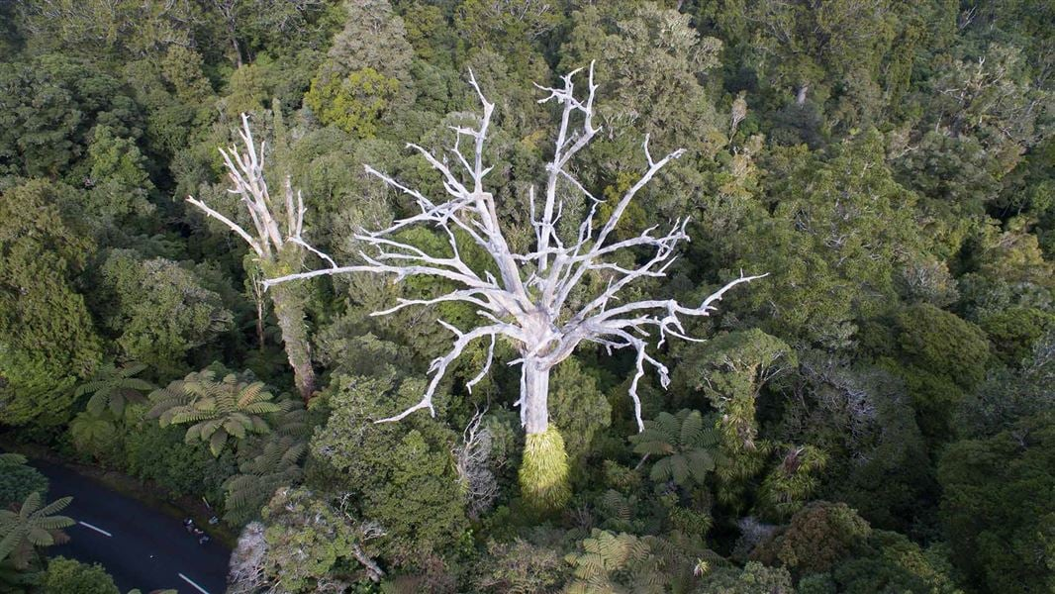
Climate-related Disclosure
Nature-related Disclosure
*now mandatory in NZ

Slide 2
Streamlining Business Investment in Nature
Integrate nature into existing climate work programmes e.g. transition planning
When identifying mitigation and adaptation options – ensure nature-based solutions are part of the mix
Develop a long list of options - Link up your property and asset managers with a nature-based solutions specialist
Upskill your board - the path to net zero is nature positive

