Slide 1
Vector’s scope 3 emissions journey
CLC Masterclass 31/08/2023
Notes:
Our goal is to keep the presentation itself relatively short, and then have more time to engage with everyone on the call for a longer Q&A session

Slide 2
An overview of Vector
Energy company
NZX listed
75.1% owned by Entrust, a private
community trust
~ 1,500 suppliers
Notes:
Most well-known for its electricity distribution line across Auckland, which consist of over 19,000 km of electricity lines and powers more than 610,000 homes and businesses
But we actually have a portfolio that includes 7 other business areas:
- Auckland’s gas distribution network (supplies gas to over 119,000 connection points)
- Fibre business operating in wider Auckland region
- Ongas LPG and Natural Gas Trading business
- HRV
- Vector Powersmart – builds and consults on large-scale solar developments
- Last but not least, our newest business unit is VTS – Vector Technology Solutions – a digital data solutions company
Additionally: Investments in 3 other energy company
Across all these business areas, we have almost 1,500 suppliers providing products or services, so you can imagine with this, and the fact that we sell & distribute gas, our value chain emissions are rather large…

Slide 3
GHG emissions FY23 (in tCO₂e)
Notes:
Majority downstream emissions – all the blue area are emissions from the use of sold products, so the combusted natural gas and LPG. – out of this, biggest piece is from gas distributed on our network, from roughly 13.5PJ gas combusted along the gas pipelines
Second biggest emissions category are purchased goods & services – green area. Largely also from gas, but emissions from other purchased products are also material, and were included in our emissions inventory for the first time this financial year.
So these are the two areas we’re going to be focussing on during this presentation – first about the work we’ve been doing to understand how our emissions from sold products will be reducing, as this area we’ve had data on for the past couple of years
Then I’ll go into talking about work we’ve been doing mainly this past financial year to more accurately quantify emissions from other products, where data isn’t as readily available.

Slide 4
Analysis of ‘Use of sold products’ emissions
Notes:
First, we’ve taken a look at our largest scope 3 emissions source – gas distributed via Vector’s Auckland gas network.
If you look at the left hand graph, you can see that gas distribution has been dropping since FY19 – the upswing this year is merely because there was a higher than normal drop due to Covid last financial year. Looking at our emissions from this source, these have dropped about 5% between FY20 to FY23.
Now if you take a look at the graph on the right hand side, industrial gas use is responsible for 80% of gas related emissions in Auckland so this is where we’ve been focussing on with regards to emissions reductions.
That is not to say we don’t care about residential gas use, quite the opposite. But we’re looking at this more from an equity perspective – how do changes on the network affect their pricing, and how can consumers be supported to transition away from gas too?
As with most of scope 3 emissions, a challenge that we have, and a challenge know too well yourselves, is that we don’t control this emission source – it’s our customers that use the gas. But we’re still wanting to understand how emissions in this space will be developing, and support our customers to decarbonise. One way we’re doing this is in the policy & regulatory space, for example through Vector’s submission on the Emissions Reduction Plan where we’re calling for more GIDI funding, to support industrial & commercial customers decarbonisation projects. The early draft here was very focussed on residential gas use, whereas – as you can see on this graph – the focus really needs to be on the industrial & commercial sector.
To better understand what we can expect over the next decades, we also engaged more closely with commercial & industrial customers over this past year, by sending out surveys to almost 100 of these gas customers. This was followed by 10 more in-depth conversations with high users on the network, to hear about their future requirements and reduction plans and understand how we might be able to support in their transition from gas to electricity and providing technical expertise where possible. Quite a few CLC members may have actually been involved in this survey, and if you did participate in the questionnaire – thank you so much for your input.
Through this engagement we were able to determine that we can expect at least a 30% reduction by 2035, either through energy efficiency measures or a transition away from gas! There was ambition for even further reductions, so it’s likely we might even see a higher reduction.
Overall, what we’re doing in this space at the moment isn’t much of a scientific mechanism to changing customer behaviour, it’s rather just coffee and chats with peers at those companies to find out their plans and reduction target, and come up with ideas to move away from gas, and by doing so getting a better picture of our own carbon footprint over the next decades.

Slide 5
GHG emissions FY23 (in tCO₂e)
Notes:
Next let’s take a look at that green area in Vector’s GHG emissions inventory, and here specifically the areas or ‘Other purchases’ and ‘Materials’, which cover all expenditure that isn’t included in other categories, and not relating to gas purchases or fuel used by our field service providers.

Slide 6
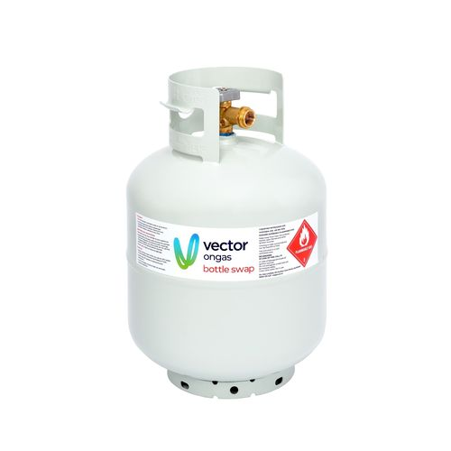
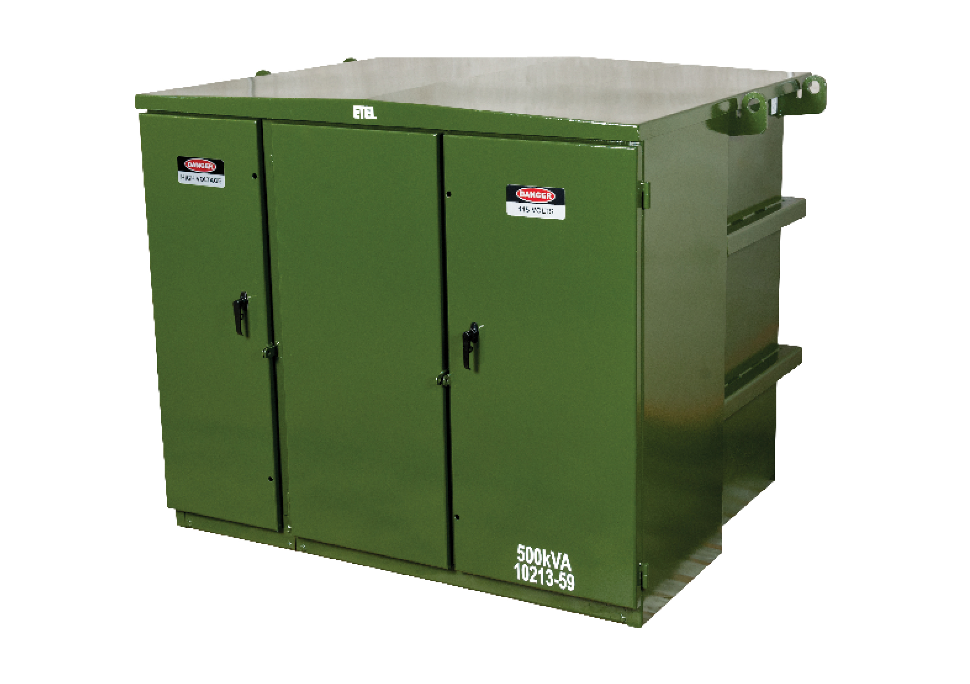
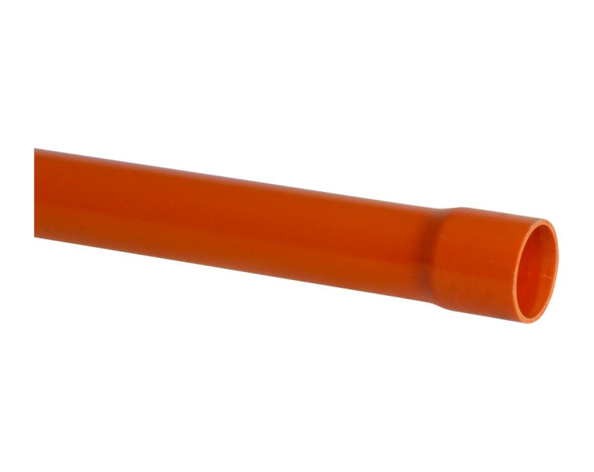
Analysis of ‘Purchased products’ emissions
Goal: Reporting to be fully aligned with GHG Protocol Value Chain (Scope 3) Standard
Incentive: Got internal business units involved through financial incentives (2.5% of staff bonus)
Scope: Focus on key suppliers, or likely high emitting materials
Notes:
While sold and purchased gas emissions were relatively easy to calculate and therefore had been published as part of our inventory since FY20, emissions from other purchased goods & services – as most of you know too well – are much harder to quantify. We had gone through a screening exercise in 2021 together with thinkstep, to understand Vector’s full scope 3 inventory, but decided at the time not to publish the results as we didn’t feel comfortable with it being rather inaccurate.
After publishing our first GHG emissions inventory report in FY22, we set ourselves the goal for the FY23 report to fully align with the GHG Protocol Value Chain Standard, which meant needed to understand and include all material scope 3 emissions. To achieve this, and feel more confident in the calculations on purchased products & services, we set an internal KPI, linked to a financial incentive, to calculate supply chain emissions for each business unit, ideally not using a spend-based approach.
Thought I’d talk a bit about how we approached this task and what we found:
Meeting with representatives from each BU with sustainability team, to share what the aim of this exercise is and ways to approach it.
Each BU to identify their key suppliers, or key materials.
BUs to contact suppliers to enquire about what data is available on their product’s emissions – ideally in form of an Environmental Product Declaration (EPD) or a product carbon footprint, alternatively to share their scope 1 – 3 emissions breakdown
In the end, we calculated mostly with data from EPDs. While some suppliers shared their scope 1 – 3 emissions with us and suggested using emissions by revenue compared to our spend with them, we found this to still not be accurate enough seeing as we didn’t know exactly which products they product, the split between products and services they offer, differences in currency conversion etc. We did calculate some emissions this way and then compared with what we were getting using the spend-based approach, and it was quite far off, so to be on the conservative side we went with the spend-based calculation for these areas.
As a stretch target we had asked staff to also find out our suppliers science-based reduction targets, to help us understand the emissions reductions we can expect and also just generally to see how engaged our suppliers are.
Overall we found this exercise to be really useful for multiple purposes:
Go deeper into the conversation on decarbonsation with suppliers
Increase staff awareness around emissions that occur before a product even gets to us (but also the other stages covered in an EPD, despite not using them for our own calculation)
Increased interest and initiative by staff from across the business in emissions calculations.
Providing information on emissions has now even been integrated into SOME supplier KPIs
And of course, we ended up with an emissions calculation that we felt more comfortable enough with to publish in this year’s GHG report.
Talk about the development of questionnaires to suppliers over time, from using GHG Protocol recommended question to what staff figured out suppliers understand better / react to more
EPDs: independently verified, based on international standards, and publicly available; focussed on the manufacture / production stage of the product

Slide 7
Results
Different approaches across the supply chain, but overall increased awareness and engagement in emission calculations, and growing GHG emissions inventory incl. product emissions
Example: Natural Gas Distribution
Key item: new pipelines
Approach: weight of installed pipeline / year by material * emission factor from Environmental Product Declaration of pipelines
Product-specific method | Spend-based method
13% emissions | 87% emissions
33 suppliers | 1,300+ suppliers
Notes:
The end results actually though turned out to be slightly different for each business unit, and I’m not going to talk in detail about each of them, but just to give one example where we probably got to as accurate a calculation as possible:
For the gas distribution network, the team identified the key item purchased to be new pipelines. So they calculated the weight of newly installed pipes by material, and multiplied this by an emissions factor for that specific type of material, taken from Environmental Product Declarations. It was great to see that most of our suppliers actually had this information available, so we were able to use own suppliers’ emissions data for most of this calculation.
Across all business areas, we were able to calculate 13% of emissions in this category not using the spend-based approach – but only covering 33 suppliers.
In comparison, the remaining 87% of emissions are made up by over 1,300 suppliers.
With more time we know we’ll be able to improve this number further – plans already in place, and we know from some suppliers that they intend to publish product carbon footprint in the next year or two
Overall: Heavy lifting came from the business units, with support from a Climate Change Steering Committee for a top-down approach. We had about 2 – 3 staff involved from each BU at least at the start, plus support from our procurement team for the financial data and our insights team helped set up an automated BI report where we ended up using the spend-based approach – so quite a lot of people involved to share the load. Took about 9 months overall though not all business areas were involved to the same extent at all times.
But once started, staff got them really engaged and now quite into it – KPIs, supplier meetings, etc.

Slide 8
Summary
Scope 3 emissions calculations take time that is worth investing
Get the whole business involved
While far from perfect, the spend-based approach can provide a good starting point to fall back on where data is not yet available
Increased enquiries from customers will increase availability of emissions data by suppliers
Few suppliers might make up the majority of product emissions, start with these key suppliers
Notes:
Worth investing: not only to be able to measure emissions, but to increase focus on emissions across your supply chain as well as staff
Whole business: get staff that are involved with supply chains involved themselves, rather than calculating emissions yourself - they are likely to have greatest oversight into what is currently being purchased, and through getting into it might then be motivated to look for products with lower emissions. Incentives can help kick things off but we saw they actually really got interested and involved as we went on and now themselves eager to keep improving.
Spend-based: Definitely not the highest accuracy – in itself, but even with allocating emission factors to a bulk of suppliers that are categorised the same, despite not necessarily providing similar products; they might themselves provide a wide variety of products but be allocated one specific factor. BUT for us the spend-based calculation was useful at the start to identify this area as a likely material emission source, and is now used where better data is simply not available yet – with the aim to decrease spend-based calculation as much as possible from here on.
Heard from suppliers that more and more companies are enquiring about this information which got them into preparing the data
So as more and more of you start to ask these questions…
This might simply be highest spend, or materials / products you know are likely to have a high emissions profile
So maybe that can be a place to start, if you haven’t yet calculated purchased goods & products emissions, or if you’re wanting to improve the accuracy of the calculations: Thinking about your supply chain, which products or product categories do you think make up the biggest part of your footprint within this category, either based on spend, quantity, or material used? Do your key suppliers have emissions information published? EPDs are public so that could be a place to start looking. Also I think this is an area that companies can work on together, e.g. via sharing questionnaires that go out to suppliers so they don’t have to respond to many different surveys that are all after the same data, or to just generally share the EPDs that are being used for certain products.

Slide 9
Questions?
Contact: Maike.Poggel@vector.co.nz
Reports: www.vector.co.nz/investors/reports

