Slide 1
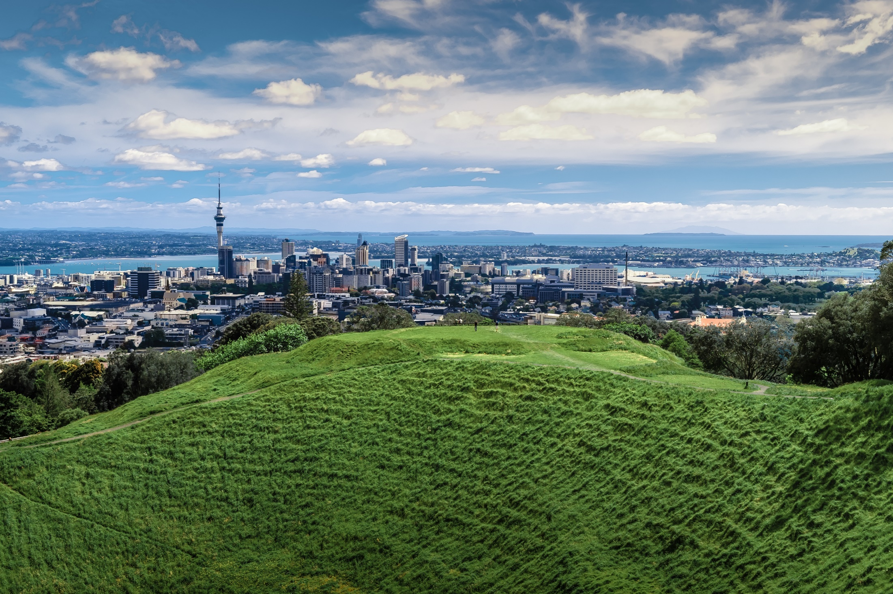
CLC Masterclass
10 tips for getting media coverage
of your organisation’s climate action
July 2022

Slide 2
#1
Make carbon reductions tangible
Notes:
Reducing your emissions is measured in terms of amount of carbon reduced/saved however nobody understands what 1000 tonnes of CO2 means.
Convert it into terms people do understand like how many petrol cars off the road, trees planted etc.

Slide 3
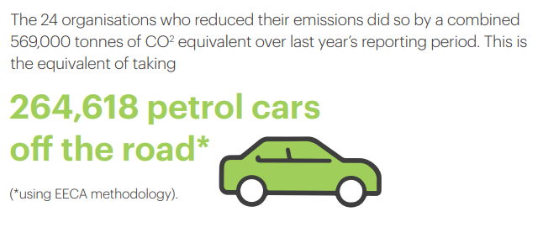
Notes:
The US Environmental Protection Authority’s free Greenhouse Gas Equivalencies Calculator allows you to convert emissions into a range of things like trees planted and cars off the road to help with your climate storytelling.
There’s also a range of calculators out there to help people work out their personal emissions if they want to take individual climate action from the US EPA, Auckland Council’s FutureFit programme and EECA’s Gen Less.
The above example is from the Coalition’s first annual snapshot report when we used EECA’s methodology to show how much carbon signatories jointly saved in the first year of the Coalition.

Slide 4
#2
If you can’t explain it simply, you don’t know it well enough
Notes:
Importance of plain language.
Ask yourself - if a journalist rang me and asked me to explain what we’ve announced can I confidently and accurately explain it to them without notes in front of you? If not, you don’t know it well enough.
Avoid climate jargon and acronyms like Scope 1, 2 and 3 emissions, net versus gross targets, TCFD, SBTIs and if using explain what they mean in plain English.
Don’t be cute, tell the truth, don’t lie and take care not to mislead. It is better to be honest and talk about the progress and challenges your organisation is facing, that omit the bad news entirely. Being proactive takes the heat out of it.

Slide 5
Overarching vision/why we should care
Key messages on what, where, why, when, how, who
Key message front-footing main criticisms
Key message on next steps
Supporting facts and figures
Notes:
The above ‘Message House’ is a useful template to use to craft your press release, media pitch.

Slide 6
#3
Put it on a plate, not just in a press release
Notes:
Putting out a press release does not guarantee you will get media coverage.
Something we’ve found that has worked well is writing a press release but then pitching it exclusively to one media who is a good fit for their story and then releasing the PR once they’ve run it.
For instance we did this for the launch of the Coalition’s new Statement of Ambition in offering it exclusively to RadioNZ’s Nine to Noon programme a week in advance of the launch. This resulted in a 20 minute feature interview. We then released the media release more widely. If we had just waited until the day and put out a press release it’s likely no-one would have covered it.

Slide 7
Notes:
Electric Air example: first electric plane in NZ and multi-record breaking flight in being the first electric plane to cross Cook Strait, longest electric flight over water in world.
Media approach:
Embargoed press release with quotes from Electric Air, Meridian who powers the plane and Wellington Airport who were hosting the plane. Also included all the interesting facts and figures about the electric plane.
Dropbox of photos available as we had a spotter plane.
Video of the plane available.
We invited media at Wellington and Blenheim to film takeoffs/landing and interview Electric Air. Invited media to take flights.
Invited VIPs in Wellington to come and see the plane including MPs, Ministers and the region’s Mayors.
Coverage was phenomonal both locally, nationally and internationally.
This example shows the value of investing in proactive media pitching.

Slide 8
#4
Get creative

Slide 9
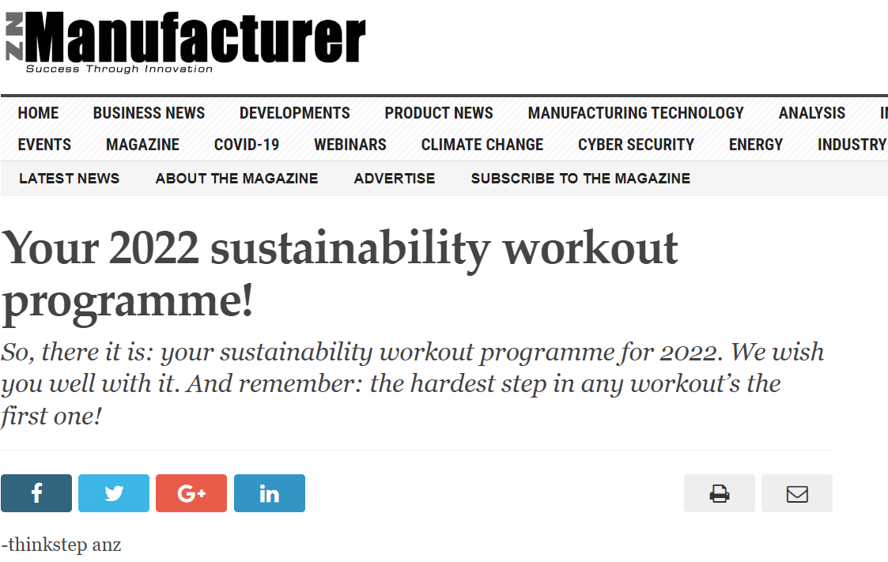
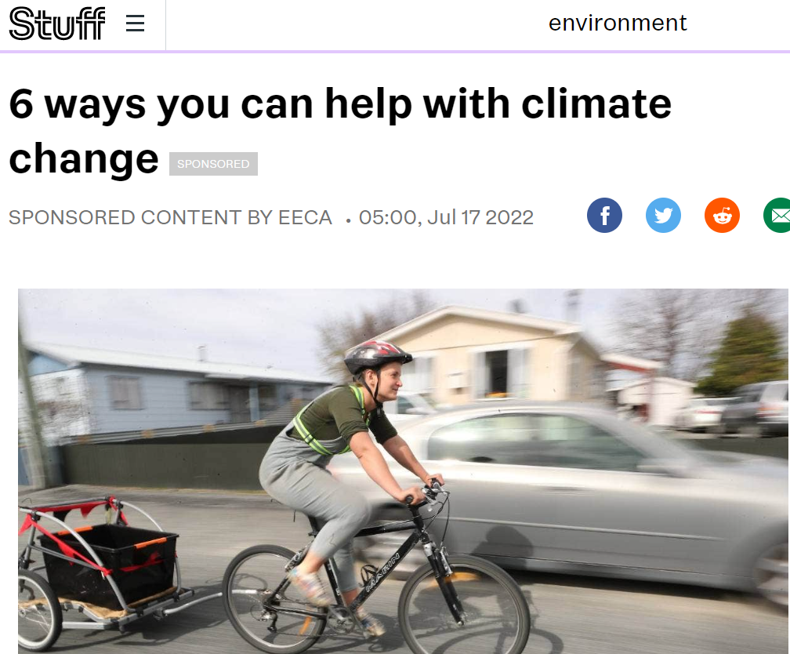
Notes:
Being creative is particularly relevant if your climate action is small (eg, a few Evs, making your office more energy efficient).
Earned media is more trusted than advertising so you can use the story to promote your climate action on your social media channels etc.
Think beyond a press release:
Pitch to local media as content is often syndicated around the country and to other pulications/platforms.
Industry media (eg: thinkstep-ANZ do a regular column in the NZ Manufacturer)
Listicles (eg, 6 ways to help with climate change).
Pitch an opinion piece from your CEO but have something to say.
Sponsored content agreements.
Try and get on a Panel (eg, RadioNZ the Panel with Wallace Chapman, Jessie Mulligan Show, TodayFM and NewstalkZB.
Self publishing on LinkedIn.

Slide 10
#5
Be timely
Notes:
The news cycle due to online media is now is incredibly fast.
If you are planning on reacting to Government policy or other announcements, your statement needs to be out there as soon as possible, preferably on the same day.
Example for us at CLC and SBC is we have a draft press release basically written and tweak it once we see the announcement.
Also think about what you can tie your climate news to (eg, COP, World Environment Day or another national or international day of significance or issues currently in the media like the need for NZ to adapt to climate change with the wet winter weather and flooding.

Slide 11
#6
Don’t bury your climate action in your Annual Report
Notes:
Separate your climate work from your Annual Report/results as they cannabilise each other and it is likely your climate work will get lost.
Have your climate action featured prominently on your website. This is also CLC’s preferance to link to this page off our website which lists each signatory.
One thing that works well for some companies is using the launch of their annual Sustainability Report to announce a new climate initiative.

Slide 12
#7
Your staff are your greatest ambassadors
Notes:
Don’t underestimate the power of your own employees and their networks on channels like LinkedIn. See your employees as ambassadors – provide them with an elevator pitch on your company’s climate action.
Example of CLC launch of new Statement of Ambition – we gave signatories a social media tile, early access to press release and had huge uptake from signatories on LinkedIn promoting the work.

Slide 13
#8
Third party support
Notes:
Think about who can validate your climate action (eg, industry representative, carbon verifier, other companies involved in the project).
For example IAG recently launched their annual Climate Change Poll which included quotes from Climate scientist James Renwick and the Climate Change Minister.
CLC and SBC want to promote signatories and members through our social media channels, the weekly SBC Panui newsletter and our websites. Let us know what you’re up to and at a minimum add us to your media mailing list.

Slide 14
#9
Ask for help
Notes:
CLC and SBC are member organisations and are here to help you.
Rebecca Lowe – SBC Comms Manager.
Rachael Cox – CLC Comms Manager
There are also other signatories we can draw on like Wright Communications.
Don’t forget about CLC Mentoring Programme, there will be an expression of interest soon for a second round, so if there is areas your organisation wants to upskill in, sign up.

Slide 15
#10
Useful resources

Slide 16
Consumer insights:
IAG Ipsos Climate Change Poll 2022
Exploring how New Zealanders relate to energy use and climate change | EECA
Carbon calculators:
US EPA Greenhouse Gas Equivalencies Calculator and carbon footprint calculator
Auckland Council's FutureFit
EECA's Genless test yourself with the household challenge action scorecard
Climate change storytelling:
The Workshop: how to talk about climate change cheat sheet
General communications:
Community Comms Collective Resources including effective messaging, reputation management, media relations, strategy and planning

Slide 17
Questions

